Slide 1
Project 2: App installation based on ads
PRESENTED BY: Hanson wu
Medha Tiwary
Jaahnavi Tiruthani
animesh kansal

Slide 2
Overview:
Introduction
Exploratory Analysis
Data Cleaning
New Variables
Sampling
AIC and SC comparison
The ROC Curve
Model Comparison
Cost sensitivity analysis

Slide 3
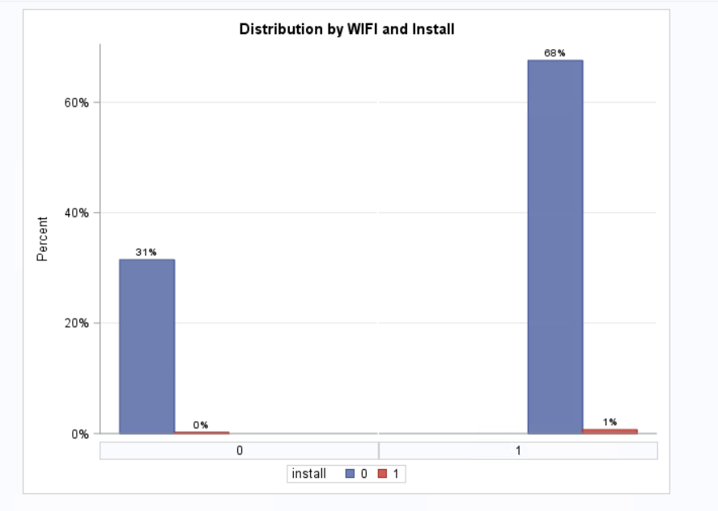
Frequency distribution for install vs WIFI

Slide 4
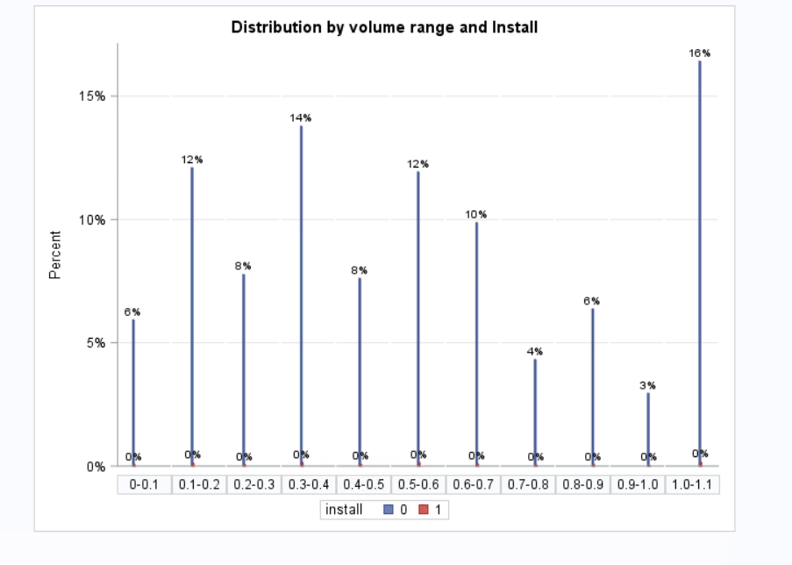
Distribution by Volume range and Install

Slide 5
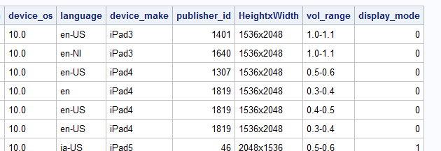
New Variable: Display Mode
Using device_height and device_width ratio to create new variable display_mode
1=Portrait
0=Landscape

Slide 6
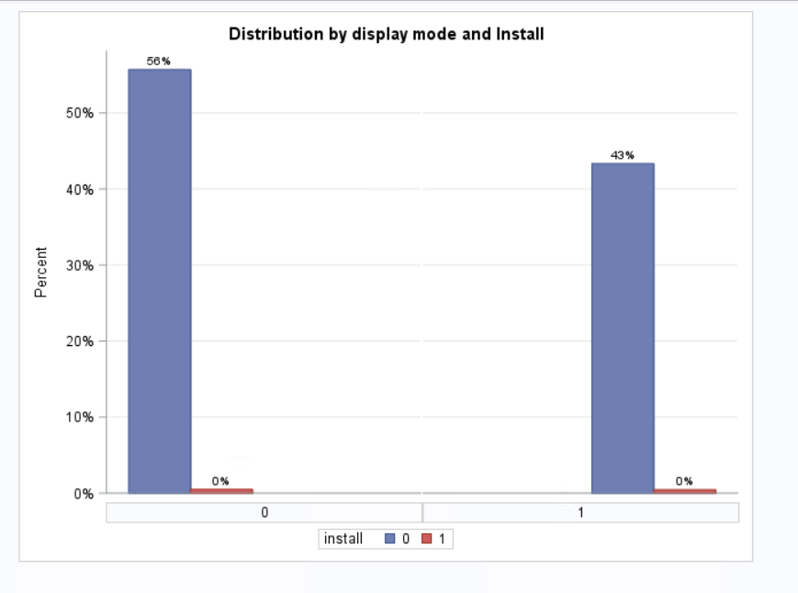
Display_mode vs Install

Slide 7
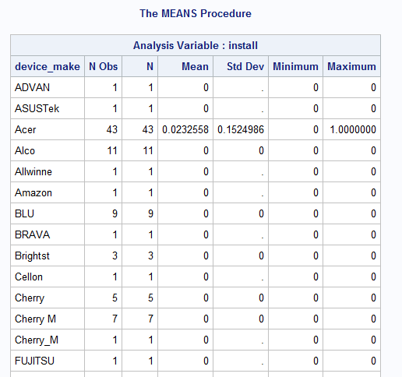
Cleaning the Data and making newtrain
publisher_id
device_make
device_os
72426 rows left after
initial data cleansing
12512 rows removed

Slide 8
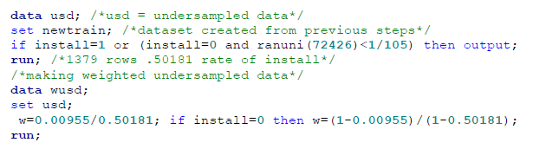
Under-Sampling the Data
Only about 0.8% installed
Too much Bias (model will predict nobody install)
Want about a 50/50 mix

Slide 9
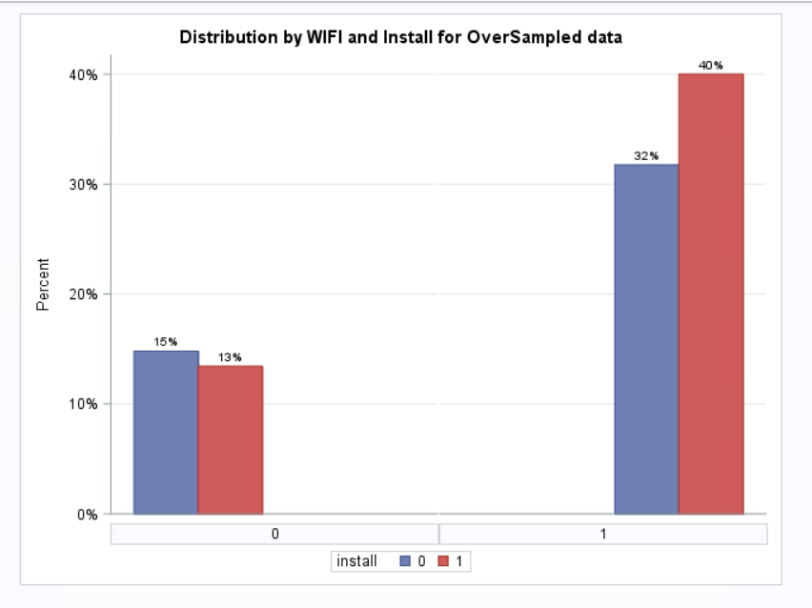
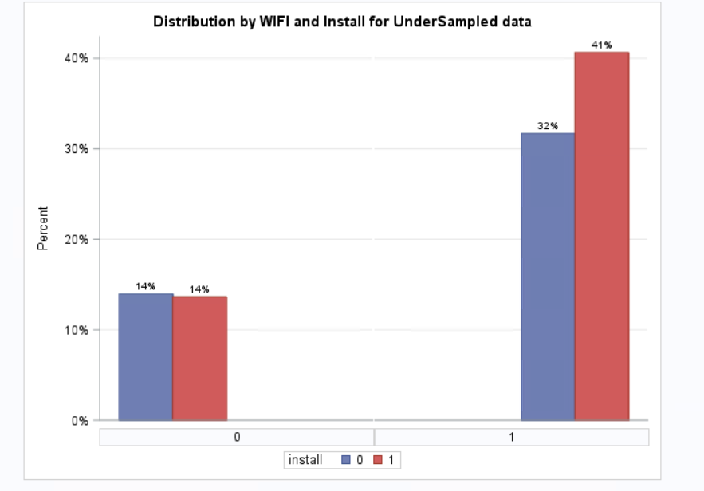
Frequency distribution for install vs WIFI
(over and under sampling)

Slide 10
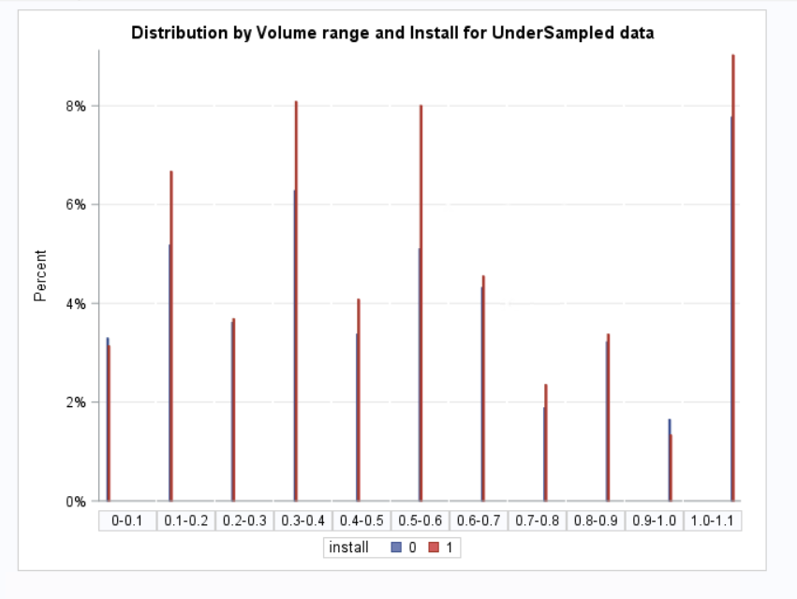
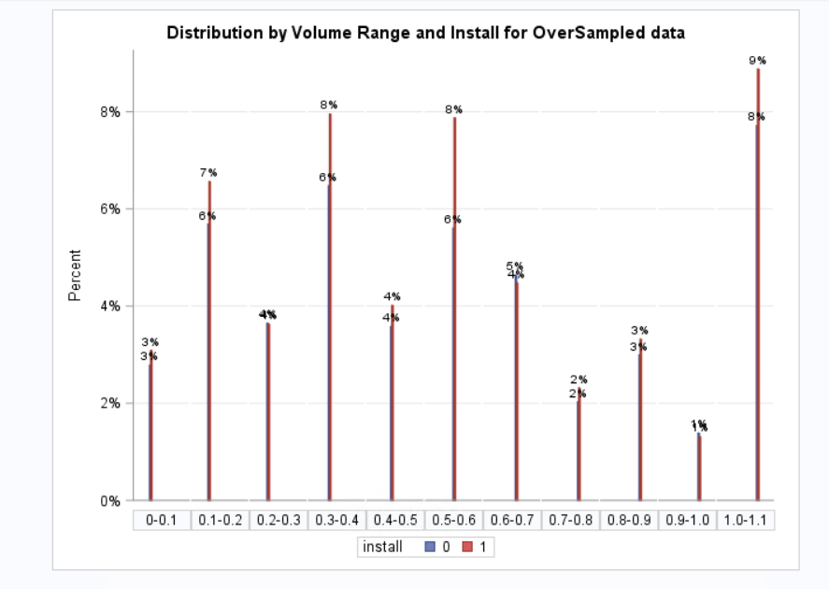
Distribution by Volume range and Install
(over and under sampling)

Slide 11
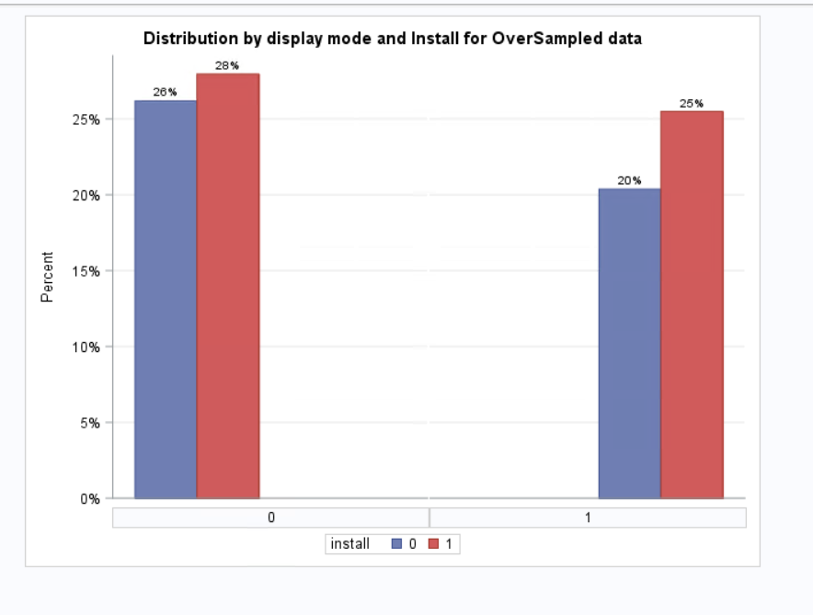
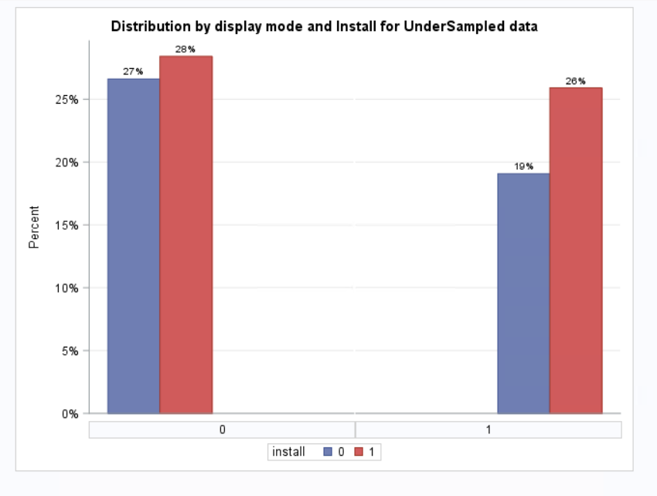
Display_mode vs Install
(over and under sampling)

Slide 12
Interaction Variable: Publisher_id*device_make
The combination of what app on what phone the ad was displayed on
Ads on some apps are annoying
Some phones can’t handle too many new downloads
Other interactions did not improve our model
E.g. device_platform*publisher_id

Slide 13
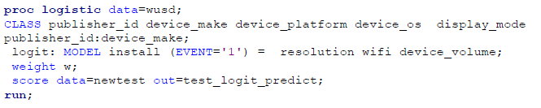
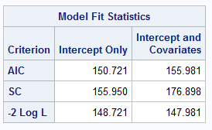
Our Logistic Model: AIC and SC

Slide 14
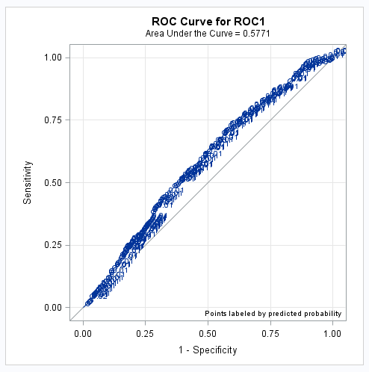
Our Logistic Model: ROC Curve
Area = 0.5771

Slide 15
We also used our model to test:
 | AIC | SC | ROC
Original Training Set | 8037.513 | 8046.862 | 0.573
New Training Set | 7815.984 | 7825.174 | 0.5753
Under Sampled Original | 131.911 | 137.126 | 0.5546
Over-sampled Original | 15616.940 | 15626.963 | 0.5730
Over-Sampled New | 17292.136 | 17302.081 | 0.5753

Slide 16
Part 2

Slide 17
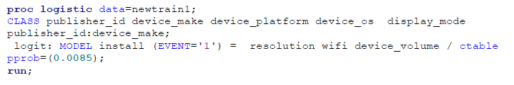
Thought Process
Want to minimize the number of errors but maintain a ratio
Want a ratio of N:1 of C1:C2 Errors
Using ctable and pprob= threshold value

Slide 18
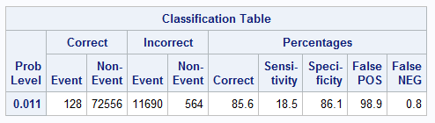
25:1 pprob=0.011
11690 C1 errors and 564 C2
ratio of about 20.7:1

Slide 19
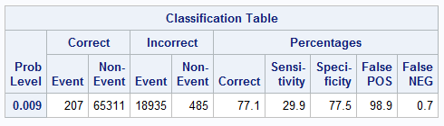
50:1 pprob=0.0085
18935 C1 errors and 485 C2
ratio of about 39:1

Slide 20
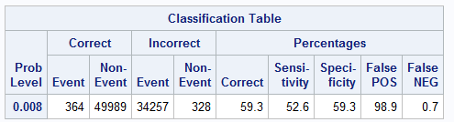
100:1 pprob=0.008
34257 C1 errors and 328 C2
ratio of about 104:1

Slide 21
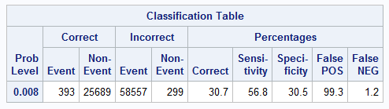
200:1 pprob=0.00788
58557 C1 errors and 299 C2
ratio of about 195.8:1
However…

Slide 22
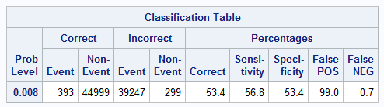
200:1 pprob=0.00790
39247 C1 errors and 299 C2
Reduces C1 errors without increasing C2 errors

Slide 23
Thank you!

